Slide 1




Fake News
Detection
Using Machine Learning

Slide 2

Introduction to Fake News Detection
Fake news has become a serious problem in today's society. In order to combat this, machine learning algorithms have been developed to detect and classify fake news. This presentation will discuss the fundamentals of fake news detection and the various methods used by machine learning algorithms.
Fake news detection is a complex task, as it requires the identification of false information and the ability to distinguish between true and false news. Machine learning algorithms can be used to detect fake news by analyzing the text, images, and other media associated with a given news article.

Slide 3

Outline
Introduction to Project
Problem Formulation
Objective
Methodology Used

Slide 4
The fake news on social media and various other media is wide spreading and is a matter of serious concern due to its ability to cause a lot of social and national damage with destructive impacts. A lot of research is already focused on detecting it.
The project is concerned with identifying a solution that could be used to detect and filter out sites containing fake news for purposes of helping users to avoid being lured by clickbait's. It is imperative that such solutions are identified as they will prove to be useful to both readers and tech companies involved in the issue.
Problem
Formulation

Slide 5
Objectives of this Project
The aim of this work is to create a system or model that can use the data of past news reports and predict the chances of a news report being fake or not. Various researchers have attempted solving this challenge in a multitude of ways to test which method works and get desirable results.

Slide 6
Methodology Used
Logistic Regression
Random
Forest
Decision
Tree
Logistic regression is used to describe data and to explain the relationship between one dependent binary variable and one or more nominal, ordinal, interval or ratio-level independent variables.
Random forest combines the output of multiple decision trees to reach a single result. Its ease of use and flexibility have fueled its adoption, as it handles both classification and regression problems.
A decision tree is a non-parametric supervised learning algorithm, which is utilized for both classification and regression tasks. It has a hierarchical, tree structure, which consists of a root node, branches, internal nodes and leaf nodes.

Slide 7
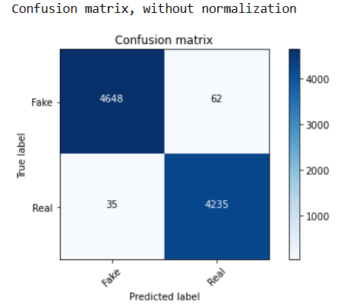
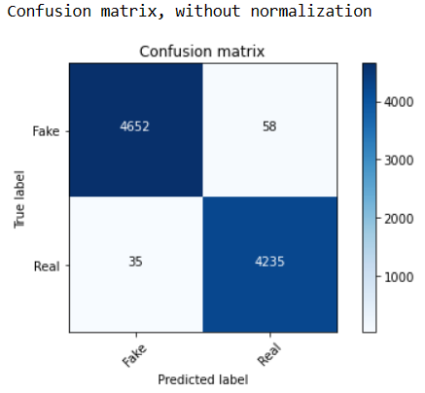
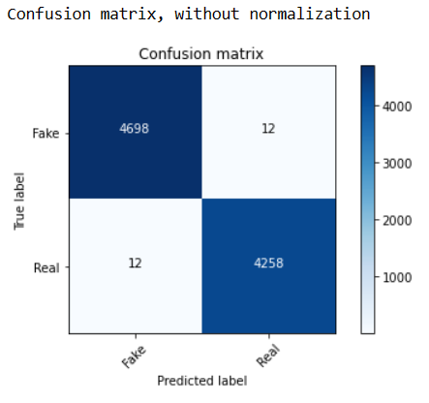
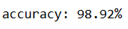
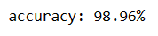
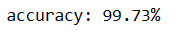
Result
With Logistic Regression
With Random Forest
With Decision Tree

Slide 8

Conclusion
Fake news is a serious problem in today's society, but machine learning algorithms offer a promising solution. By analyzing patterns and identifying characteristics of fake news, these algorithms can help us distinguish between real and fake news and prevent the harmful effects of misinformation.
As technology continues to advance, it is important that we continue to develop and refine these algorithms to ensure their accuracy and effectiveness in predicting fake news.

Slide 9

Meet The Team
Aryan Chaudhary
(20BCS6620)
Mohit Gupta
(20BCS6574)
Chirag Kalra
(20BCS6601)
Kartikey Chauhan
(20BCS6693)

